Slide 1
Loan Repayment Prediction
Santosh Ganti
Vijay Karigowdara

Slide 2
Outline
Goal
Introduction
Dataset Description
Data Analysis
Data Cleaning
Feature Transformation
Data Sampling
Attribute Selection
Classification Algorithms
Conclusion
References

Slide 3
Goal
Lend loan or not.
How risky is the borrower?
Determine the Interest rate.
The riskier the borrower, the higher the interest rate.
Profit for Investors.

Slide 4
Introduction
Loan data is obtained from Lending Club USA
Operates an online lending platform that enables borrowers to obtain a loan.
Lending Club is the world's largest peer-to-peer lending platform.
Lending Club enables borrowers to create unsecured personal loans between $1,000 and $40,000.
Loan data from year 2007 to 2018 .
Data is loaded into JMP Pro.

Slide 5
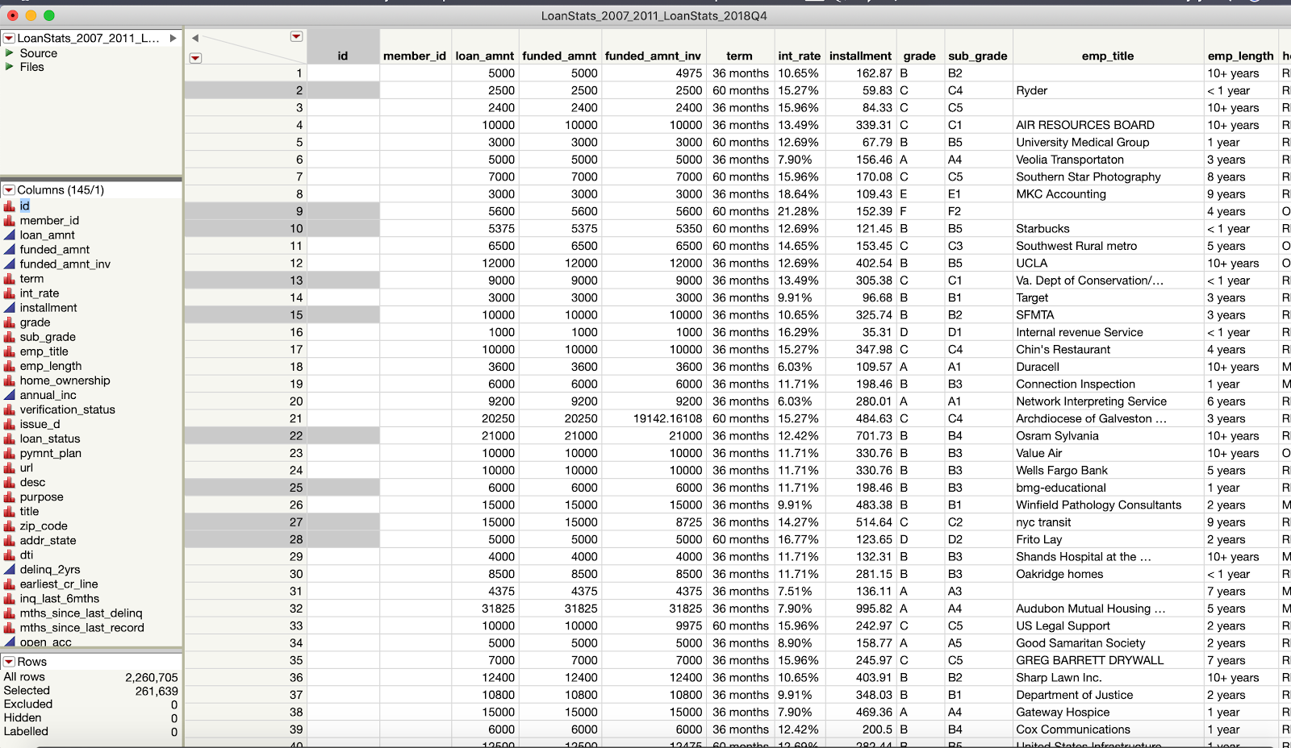
Dataset Description
145 columns and 2,260,705 rows.

Slide 6
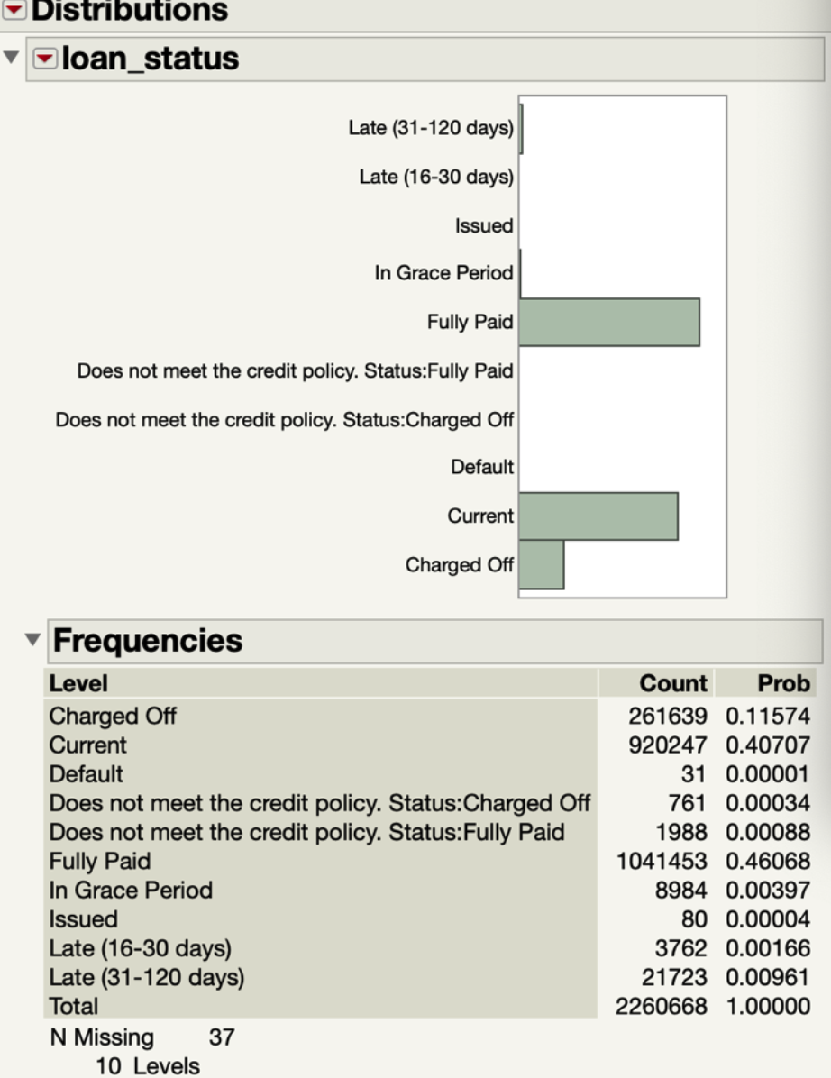
Class Attribute
Loan_status
Defaulter
Not-Defaulter

Slide 7
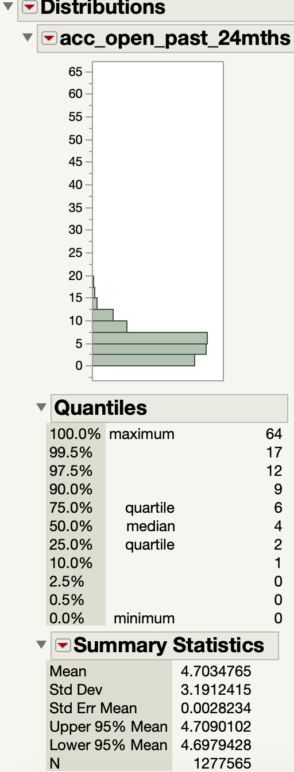
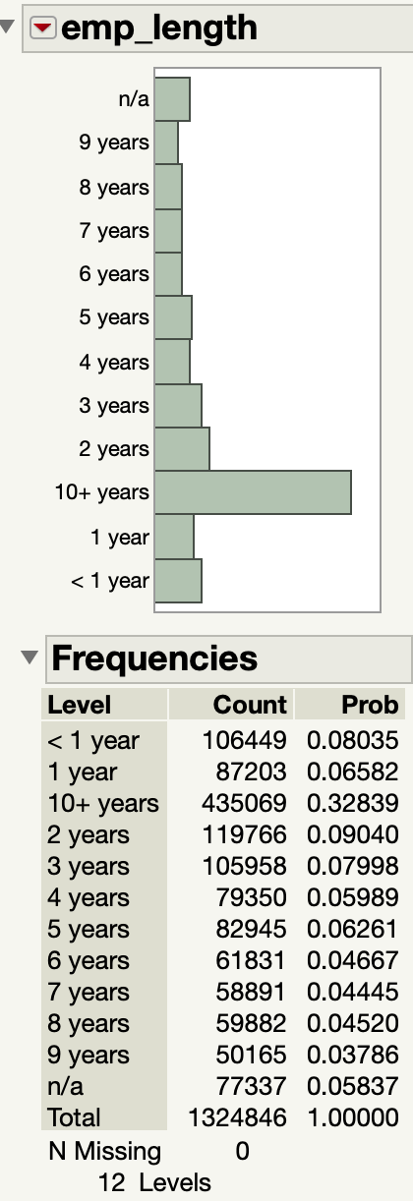
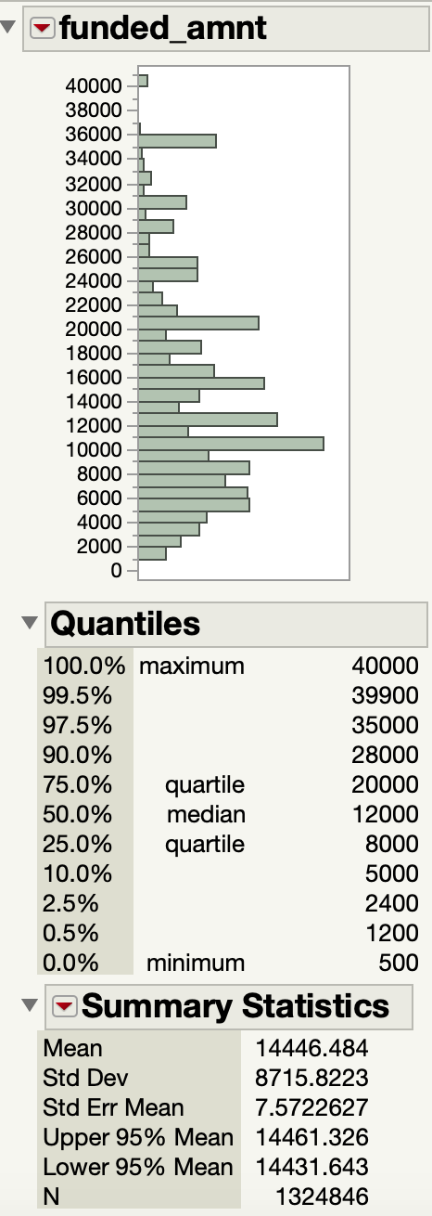
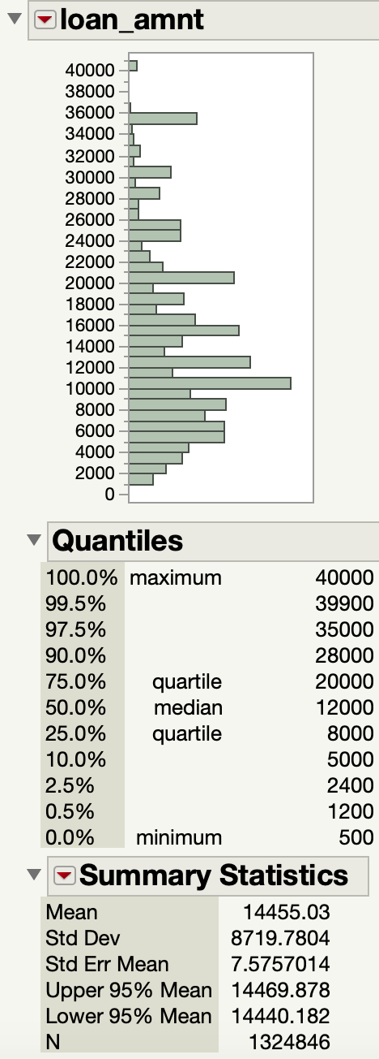
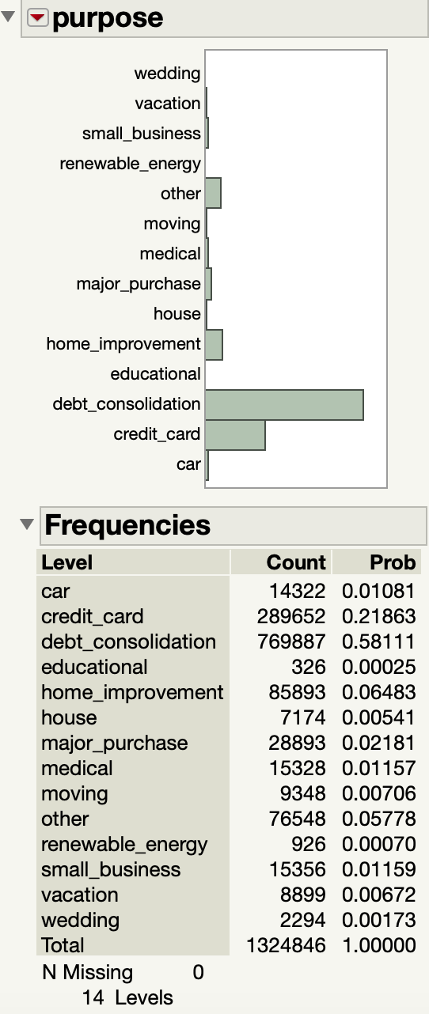
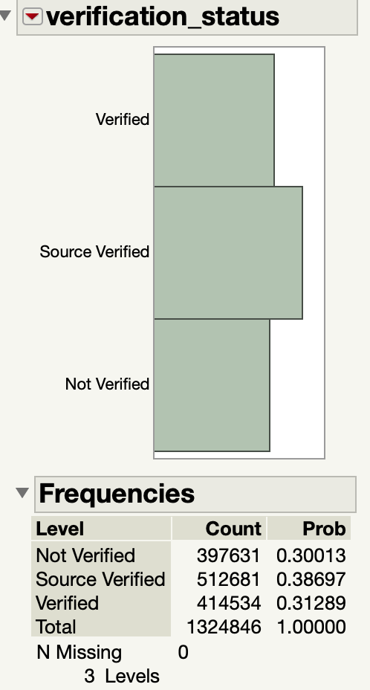
Data Analysis
Data distribution

Slide 8
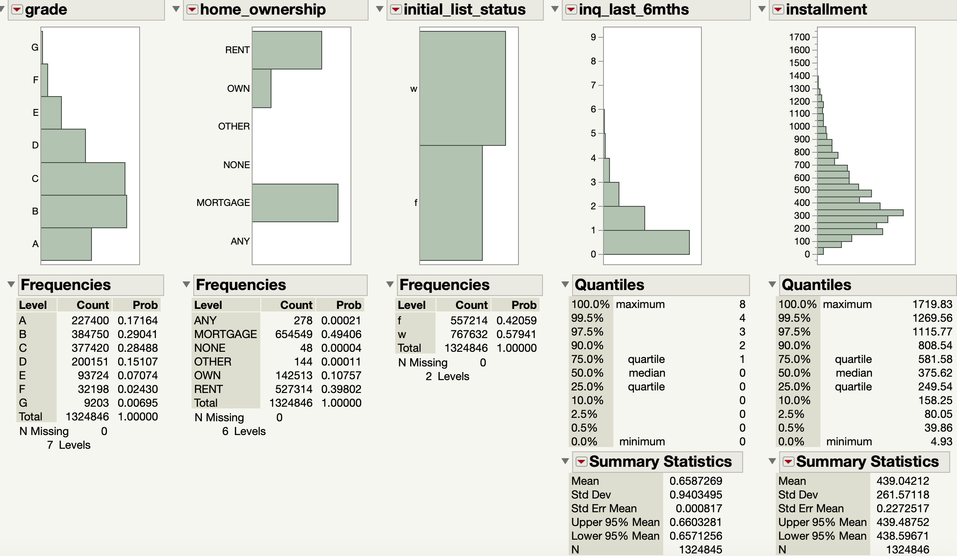

Slide 9
Data Cleaning
Criteria:
Remove high percentage of missing values.
Removing columns with very low variance.
Examining Pairwise Correlation.
Manual Examination
Unwanted columns, example: columns with date, description etc.

Slide 10
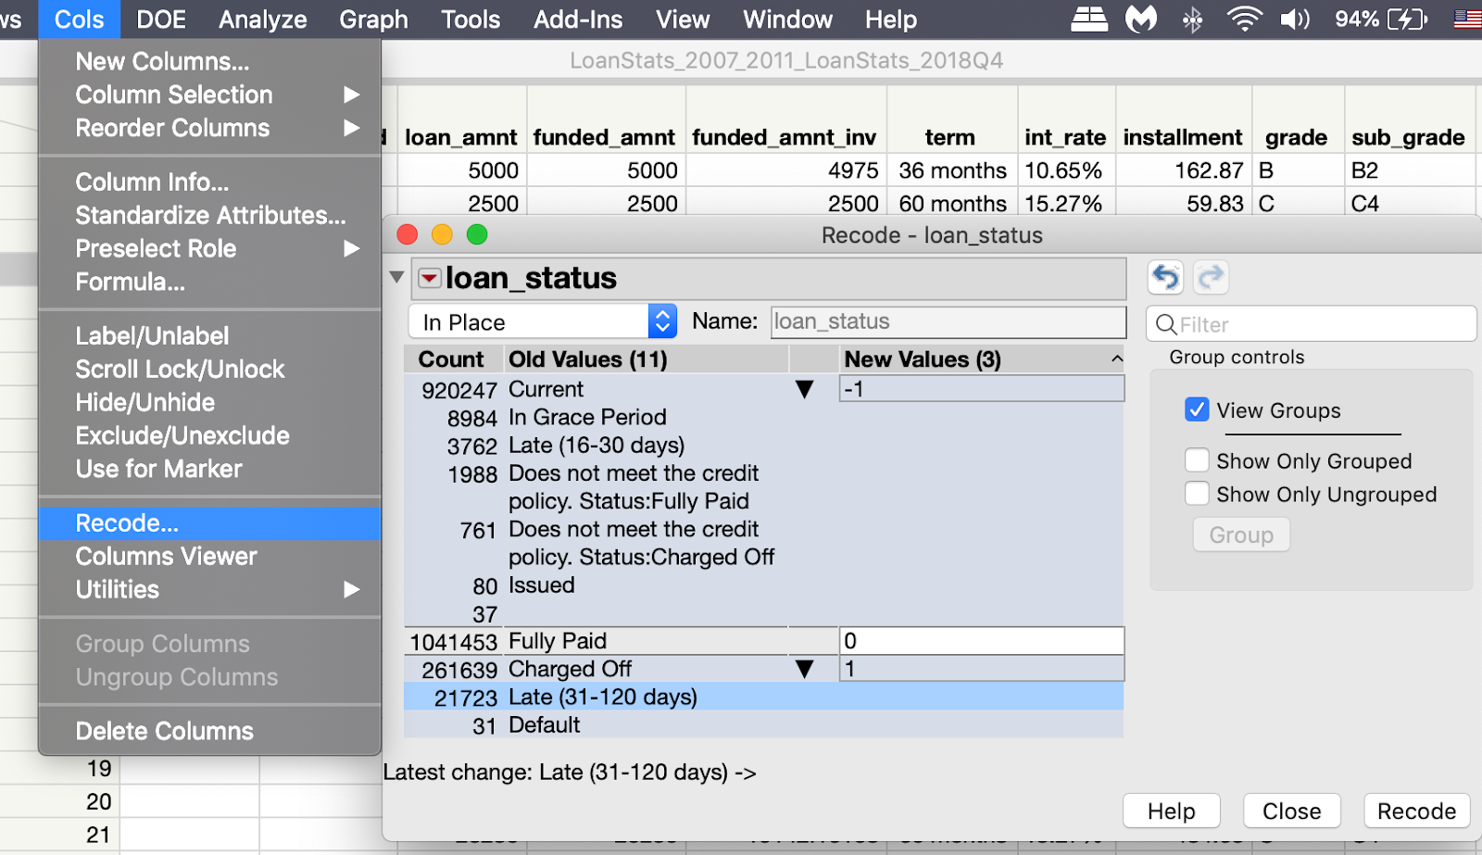
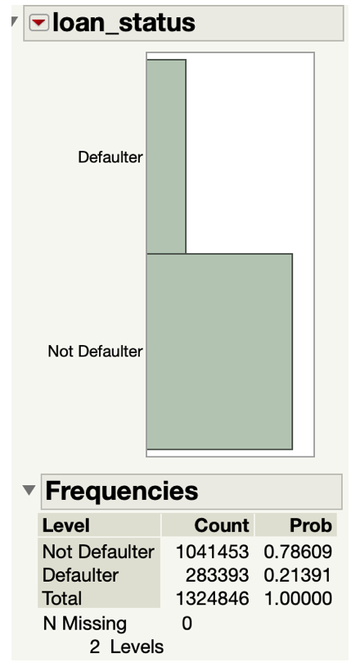
Data Cleaning contd.
Class Attribute: Loan_status
After removing irrelevant data, remaining tuples are 13,24,846 tuples.
Before After

Slide 11
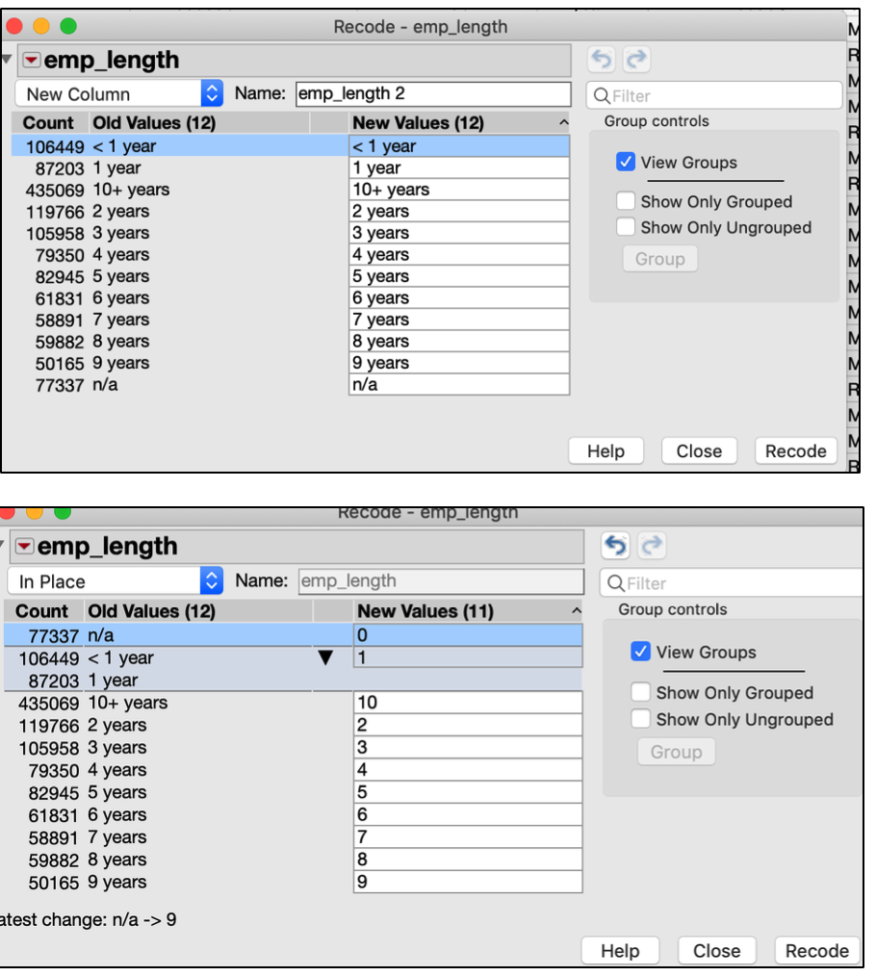
Feature Transformation
Emp_length
Loan_status
Defaulter
Not-Defaulter
Grade
Nominal to Ordinal
Others
Nominal to Continuous

Slide 12
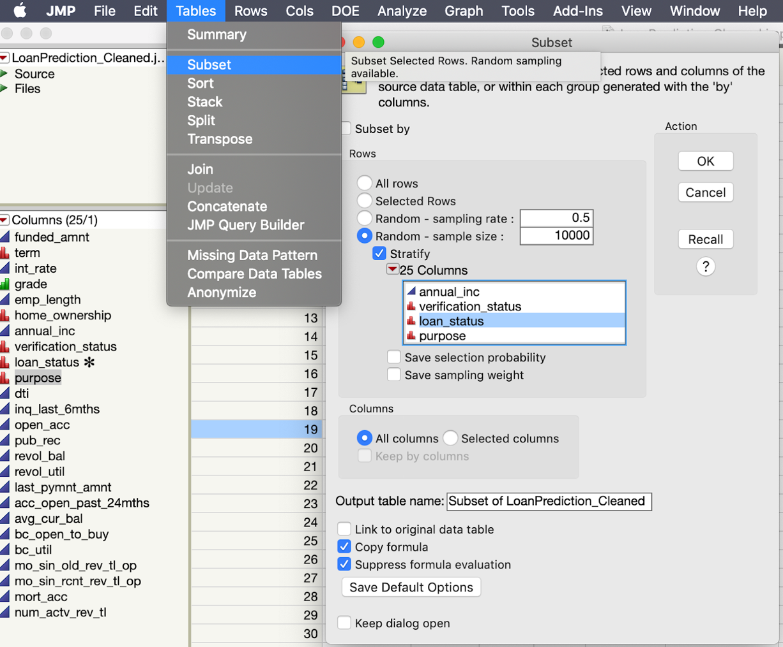
Data sampling
Taking subset of the data based on class attribute.

Slide 13
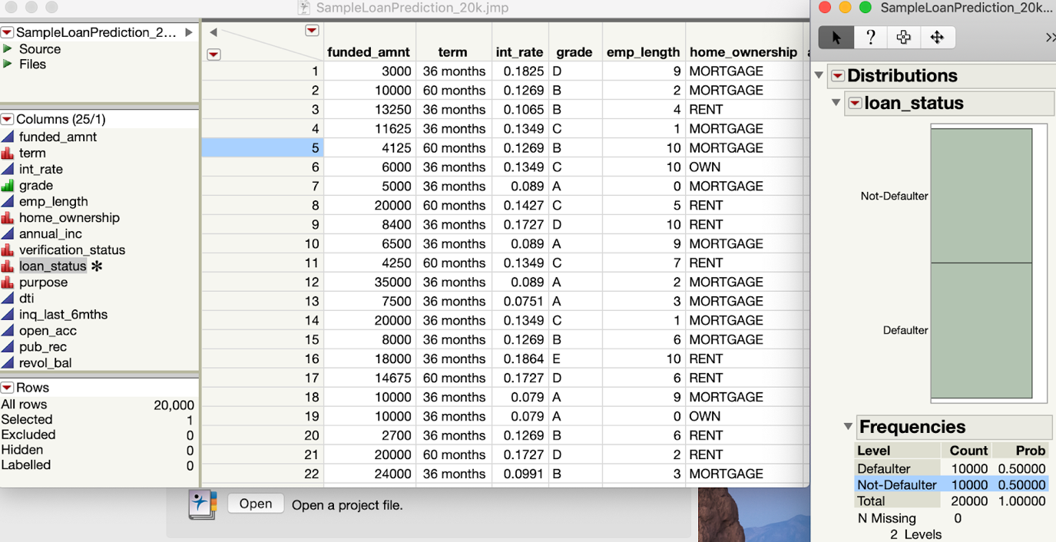
Handling Class Imbalance
After sampling, Tuples: 20,000.
JSL script to convert JMP data to CSV file.

Slide 14
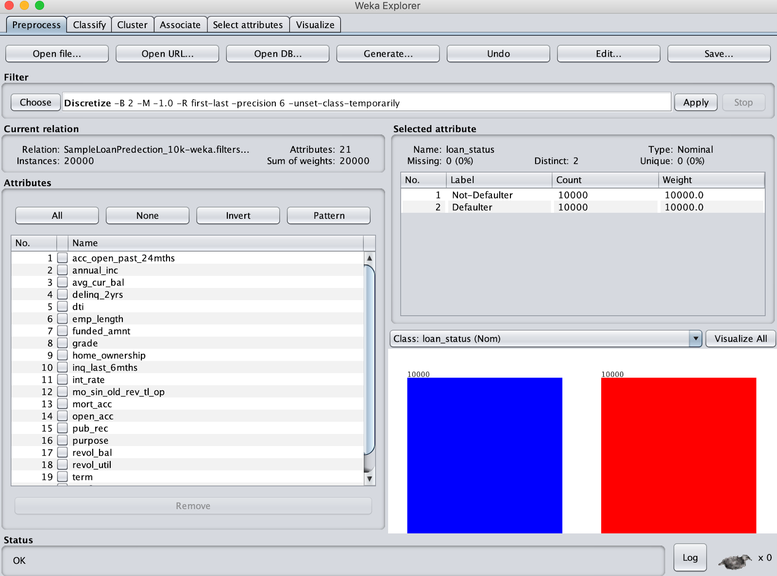
Handling Missing Data
Data Loading into Weka
Missing data Columns
acc_open_past_24mnths
mo_since_old_rev_tl_op
avg_cur_bal

Slide 15
Attribute Selection
Correlation Attribute
This algorithm computes the correlation between all features and the output class and selects the best feature subset.
Gain Ratio Attribute
It evaluates the worth of an attribute by measuring the gain ratio with respect to the class.
ReliefF Attribute
It is based on the identification of feature value difference between nearest neighbour instance pairs.
OneR Attribute
It is a classification algorithm that generates one rule for each predictor in the data, then selects the rule with the smallest total error as its "one rule”.
Symmetric Uncertainty Attribute
This algorithm overcomes the bias of information gain towards the features with the more values by normalizing its value to the range[0,1]
Infogain
Attributes that contribute more information will have a higher information gain value and can be selected, whereas those that do not add much information will have a lower score and can be removed.

Slide 16
Classification Algorithms
Naïve Bayes Algorithm
Naive Bayes classifiers assume that the value of a particular feature is independent of the value of any other feature, given the class variable
Random Forest
Random forests are a way of averaging multiple deep decision trees, trained on different parts of the same training set, with the goal of reducing the variance
Simple Logistic
Logistic regression is an important machine learning algorithm. The logistic function is a sigmoid function, which takes any real input and outputs a value between zero and one;
J-48
C4.5 builds decision trees from a set of training data in the same way as ID3, using the concept of information entropy

Slide 17
Performance - 1
Attribute | Classification | Accuracy | Precision | F-measure | ROC Area
Correlation | Naïve Bayes | 82.465% | 0.848 | 0.822 | 0.375
 | J48 | 84.95% | 0.853 | 0.849 | 0.903
 | Random Forest | 85.615% | 0.861 | 0.856 | 0.933
 | Simple Logistic | 84.385% | 0.854 | 0.698 | 0.917
Gain Ratio | Naïve Bayes | 82.385% | 0.848 | 0.821 | 0.3779
 | J48 | 85.035% | 0.855 | 0.850 | 0.899
 | Random Forest | 85.6% | 0.861 | 0.855 | 0.932
 | Simple Logistic | 84.52% | 0.853 | 0.844 | 0.918
InfoGain | Naïve Bayes | 82.66% | 0.852 | 0.823 | 0.3728
 | J48 | 84.83% | 0.852 | 0.848 | 0.891
 | Random Forest | 85.695% | 0.862 | 0.856 | 0.934
 | Simple Logistic | 84.53% | 0.853 | 0.844 | 0.918

Slide 18
Performance - 2
Attribute | Classification | Accuracy | Precision | F-measure | ROC Area
ReliefF | Naïve Bayes | 83.555% | 0.869 | 0.832 | 0.3568
 | J48 | 86.385% | 0.871 | 0.863 | 0.911
 | Random Forest | 86.315% | 0.868 | 0.863 | 0.935
 | Simple Logistic | 85.62% | 0.866 | 0.855 | 0.923
One R | Naïve Bayes | 83.685% | 0.864 | 0.834 | 0.3532
 | J48 | 84.715% | 0.851 | 0.847 | 0.888
 | Random Forest | 85.705% | 0.862 | 0.857 | 0.932
 | Simple Logistic | 84.7% | 0.856 | 0.846 | 0.918
Symmetric Uncertainty | Naïve Bayes | 82.52% | 0.849 | 0.822 | 0.3757
 | J48 | 84.98% | 0.853 | 0.849 | 0.894
 | Random Forest | 85.63% | 0.861 | 0.856 | 0.933
 | Simple Logistic | 84.53% | 0.853 | 0.844 | 0.918

Slide 19
Conclusion
J-48 classifier with ReliefF attribute classifier gives us the best accuracy.
As we can’t only use Accuracy as the only precision to measure our best model, other measures like F-measure and ROC are considered.
Using ROC as an important feature, we found that Random Forest with ReliefF attribute evaluation algorithm gives the best model.

Slide 20
References
https://www.lendingclub.com/info/download-data.action https://towardsdatascience.com/introduction-to-naive-bayes-classification-4cffabb1ae54 http://weka.sourceforge.net/doc.dev/weka/attributeSelection/GainRatioAttributeEval.html https://en.wikipedia.org/wiki https://www.ripublication.com/ijacst18/ijacstv8n1_01.pdf

Slide 21
Thank You

